Slide 1
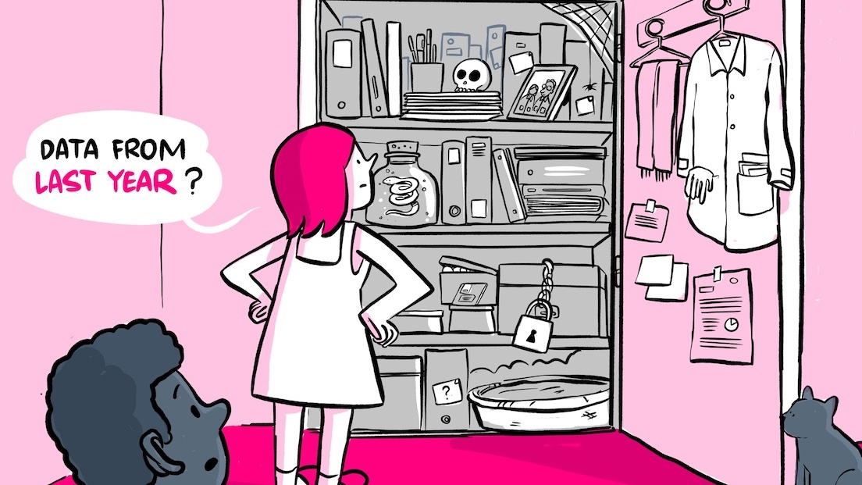


Research Data Management
Nami Sunami
Data Steward
n.sunami@tue.nl
Research Data Management: making it possible to retrieve data from last year. The Turing Way project illustration by Scriberia. Original version on Zenodo. Community & Scriberia (2020).
DOI: 10.53962/gdkf-a36m
orcid.org/0000-0001-5482-8370
This work is marked with CC0 1.0
Notes:
Image: Research Data Management: making it possible to retreive data from last year. The Turing Way project illustration by Scriberia. Original version on Zenodo. http://doi.org/10.5281/zenodo.3695300

Slide 2
After this part, you’ll be able to…
Evaluate your own research data management practices in the research data life cycle
Apply strategies to make your research data Findable, Accessible, Interoperable and Reusable (FAIR)
Open & FAIR Data

Slide 3
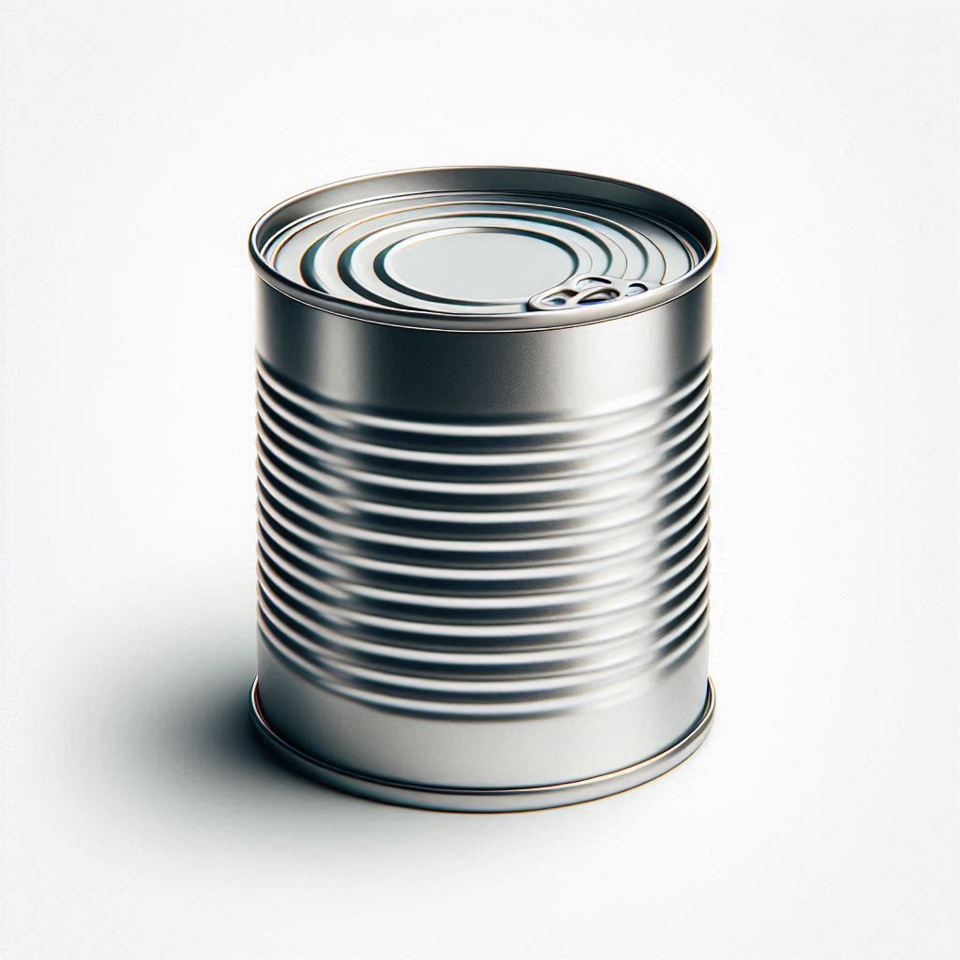
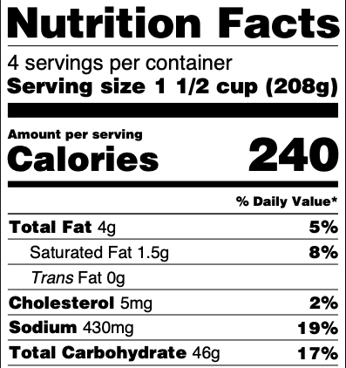
"Research Data"
Data itself
Metadata
Notes:
In this presentation, we use Research Data as including Data Itself and Metadata

Slide 4
“Research Data Management”
the way you collect, analyze, store, share, archive and publish research data, to satisfy the needs of current and future data users​
Notes:
Research data management concerns the way you collect, analyze, store, share, archive and publish research data, to satisfy the needs of current and future data users​.

Slide 5
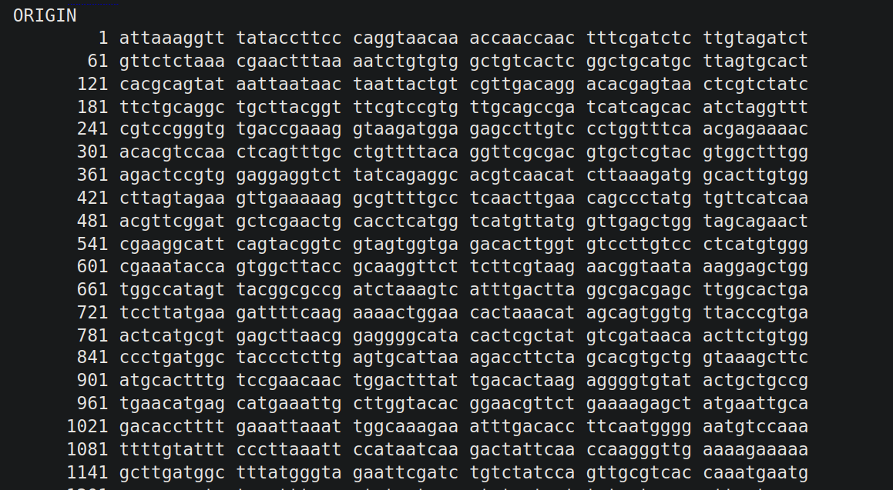
Notes:
The genome of the coronavirus sequenced by Yanmei Chen at Yong-Zhen Zhang's lab at Funan
GenBank
https://www.ncbi.nlm.nih.gov/nuccore/MN908947
https://papers.ssrn.com/sol3/papers.cfm?abstract_id=3934022

Slide 6

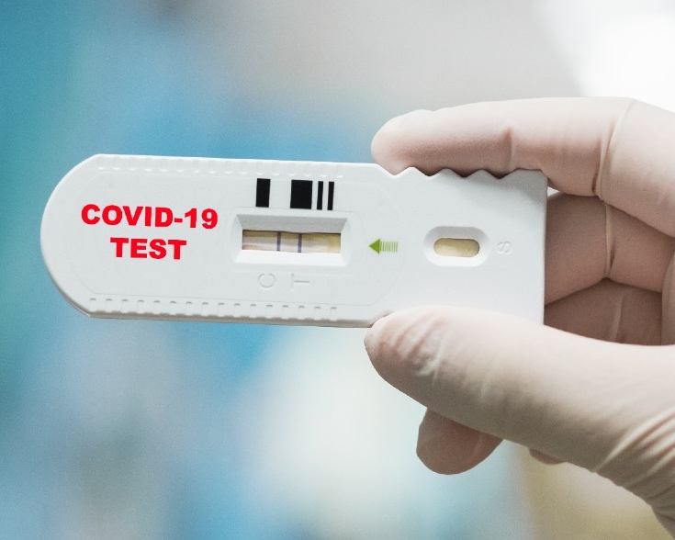
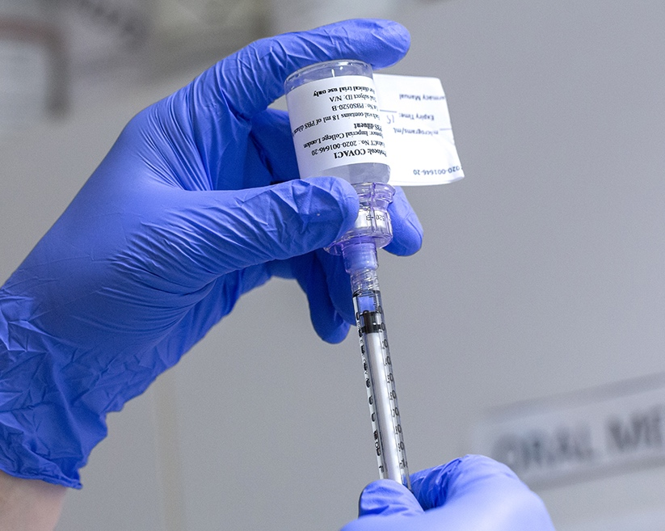

Coronavirus genome sequence
GenBank
GenBank: https://www.ncbi.nlm.nih.gov/nuccore/MN908947
Notes:
COVID test: https://images.wired.it/wp-content/uploads/2020/05/07150304/coronavirus-test-saliva.jpg
Vaccine: https://blogs.imperial.ac.uk/imperial-medicine/files/2020/09/200624_covid-19_crf_imp_vaccine_trial_0252.jpg

Slide 7
Open & FAIR Data drive innovation
(& save lives)
Notes:
Remember COVID. Glad that we are alive. We are standing (and living) on the shoulder of the giant
https://en.wikipedia.org/wiki/COVID_Moonshot
https://en.wikipedia.org/wiki/Impact_of_the_COVID-19_pandemic_on_science_and_technology#Open_science

Slide 8
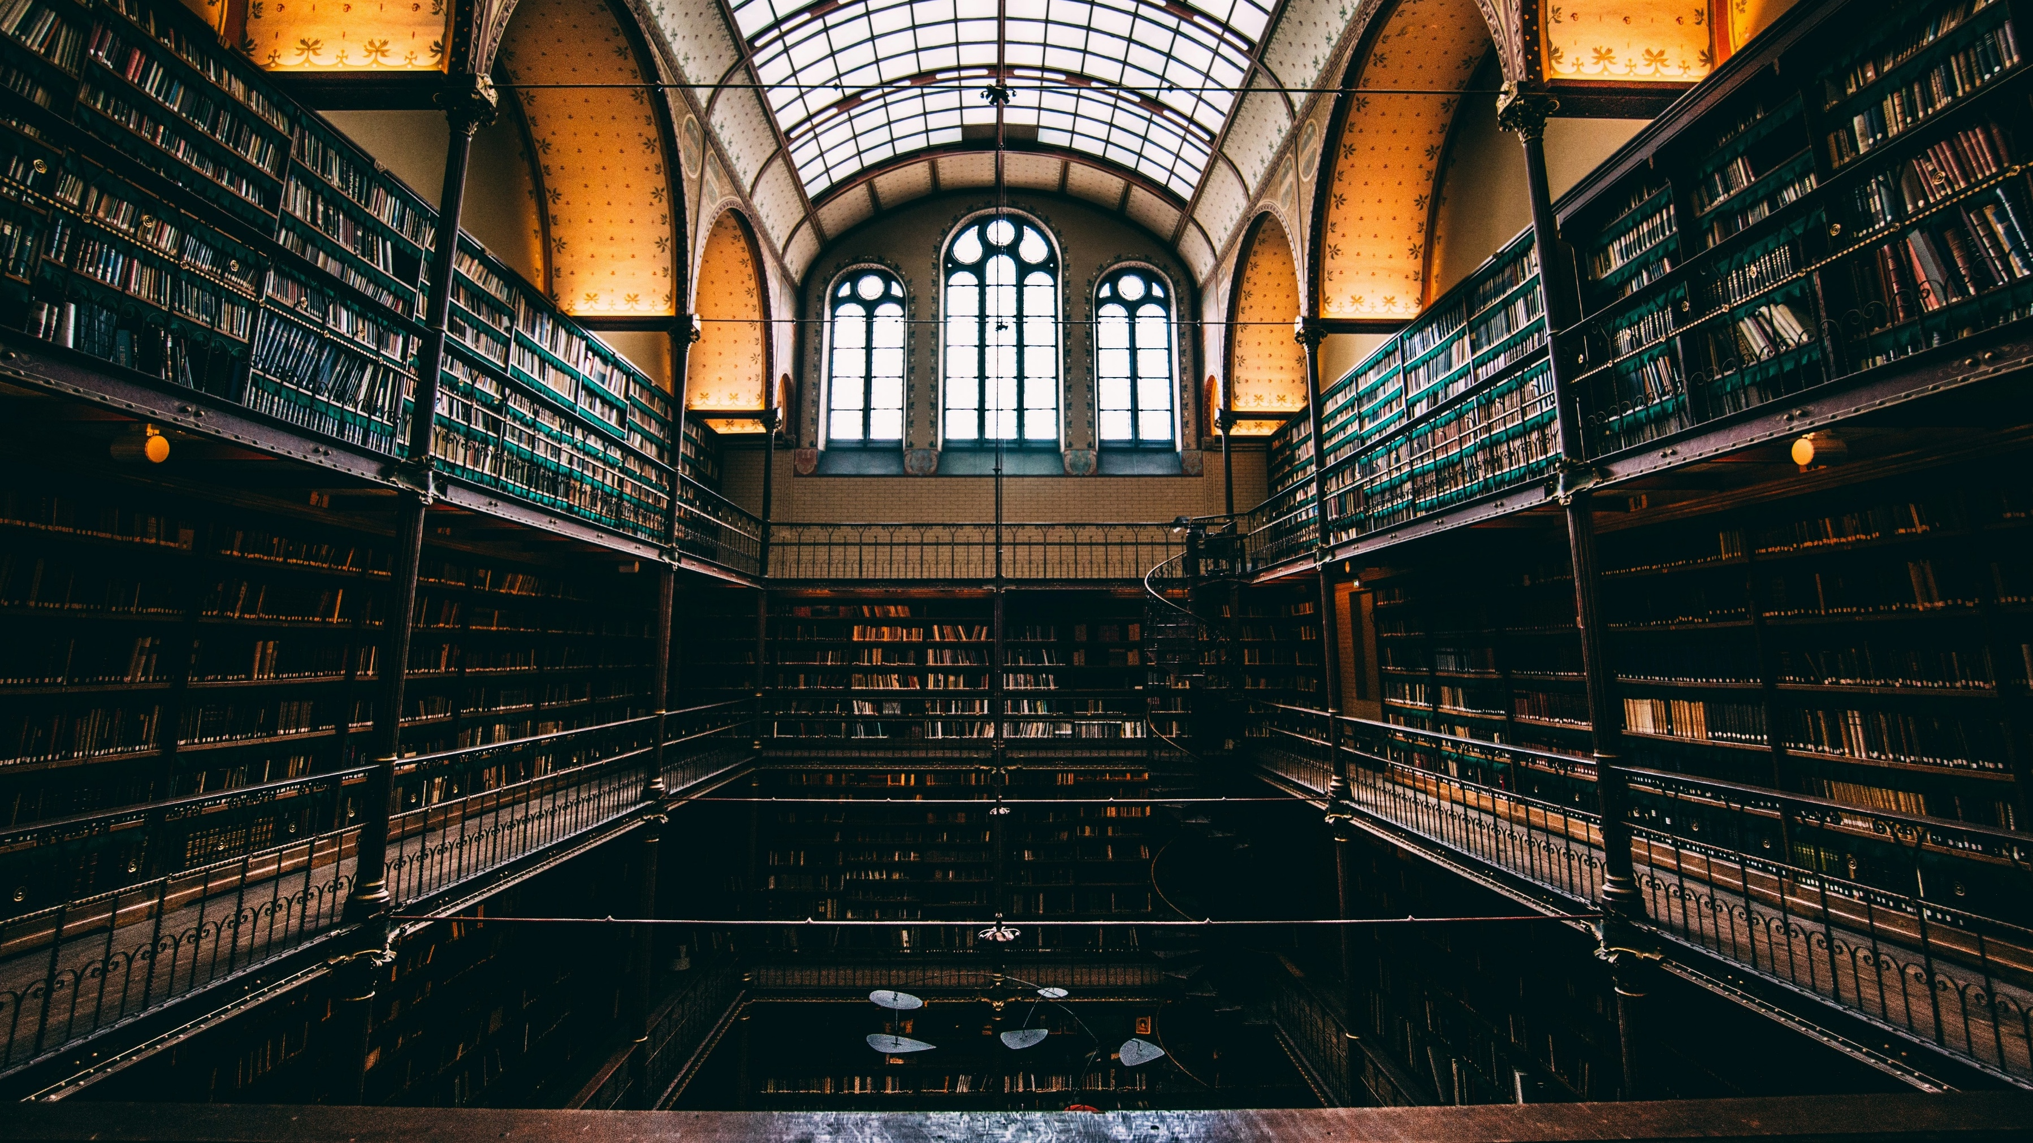
Research Data: public good
Photo by Will van Wingerden on Unsplash
unesco.org/en/open-solutions/open-data

Slide 9
Journals are asking for data
38% requiring data sharing
Based on 2017 data from 709 journals in life, health, and physical sciences.
Kim, J., Kim, S., Cho, H.-M., Chang, J. H., & Kim, S. Y. (2020). Data sharing policies of journals in life, health, and physical sciences indexed in Journal Citation Reports. PeerJ, 8, e9924. https://doi.org/10.7717/peerj.9924

Slide 10
What do ”Open” & “FAIR” mean?

Slide 11
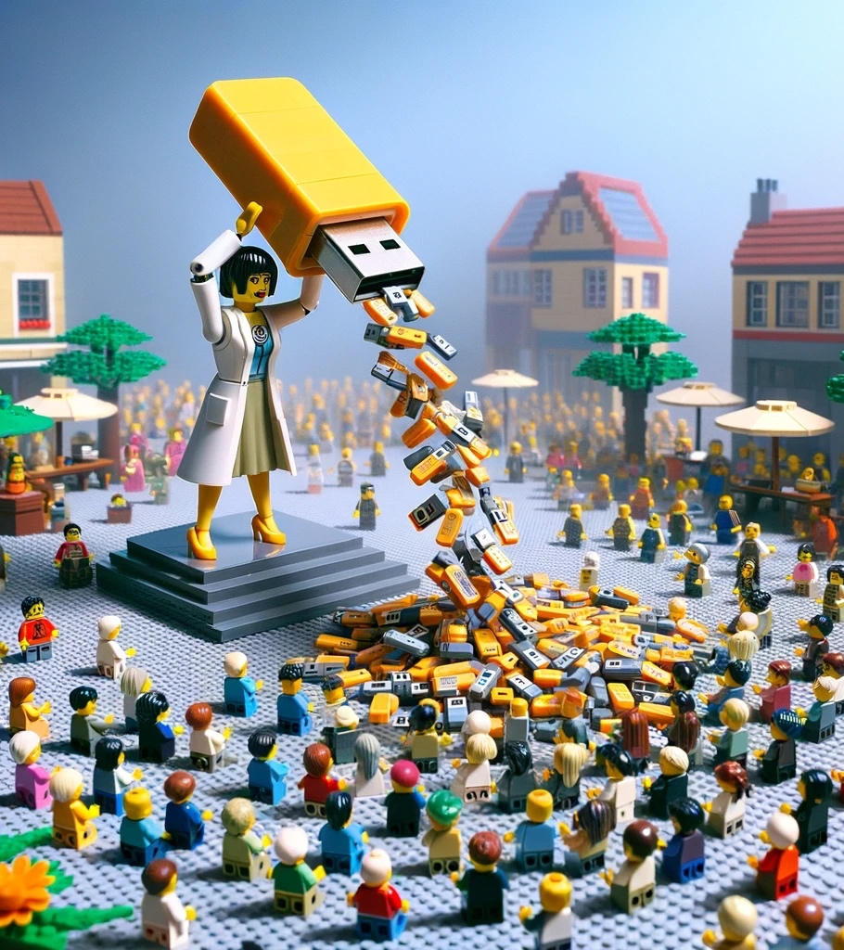
Open data is data anyone can freely access, use, modify, and share for any purpose
Notes:
We can have a visual of Open Data being on one end of a continuum, before the FAIR data
(Start with FAIR, and if there's no restriction, make your data Open Data)

Slide 12
Not all data can be shared freely
FAIR Data
Notes:
Still, we can tell what’s inside: just like a canned tomato soup -> that’s why we have FAIR

Slide 13
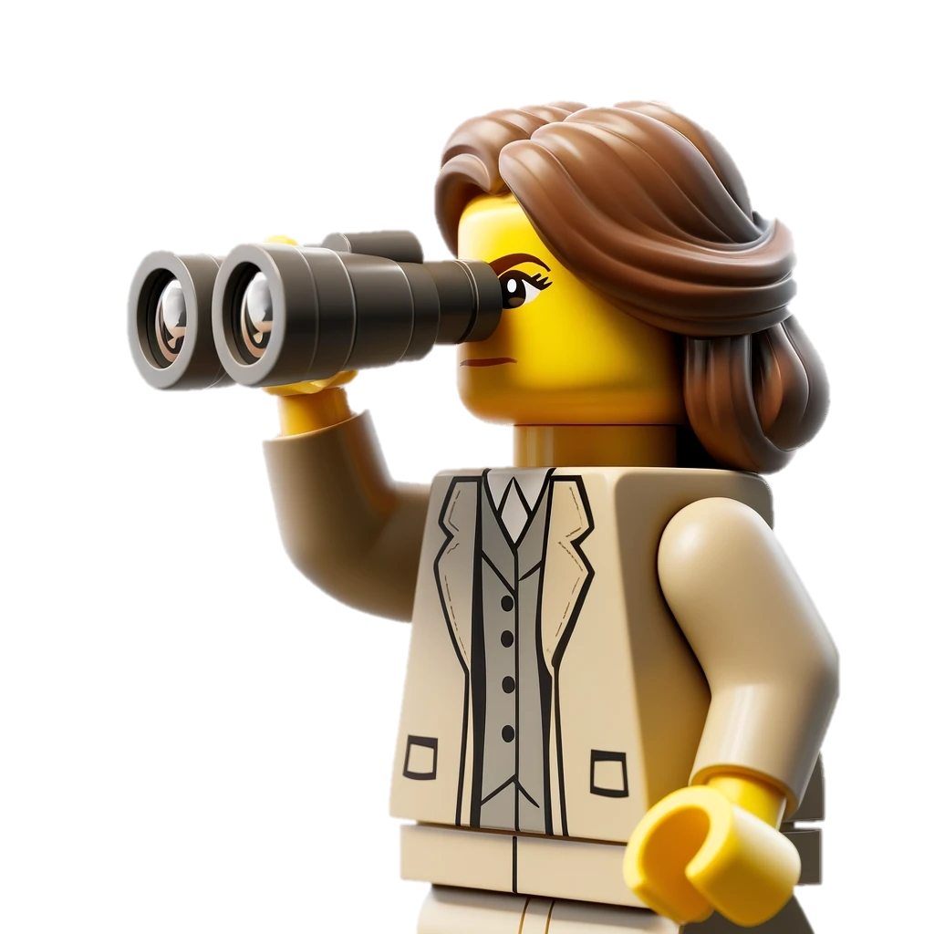
FAIR Data is data that satisfies FAIR Principles
Findable

Slide 14

FAIR Data is data that satisfies FAIR Principles
Findable
Accessible

Slide 15
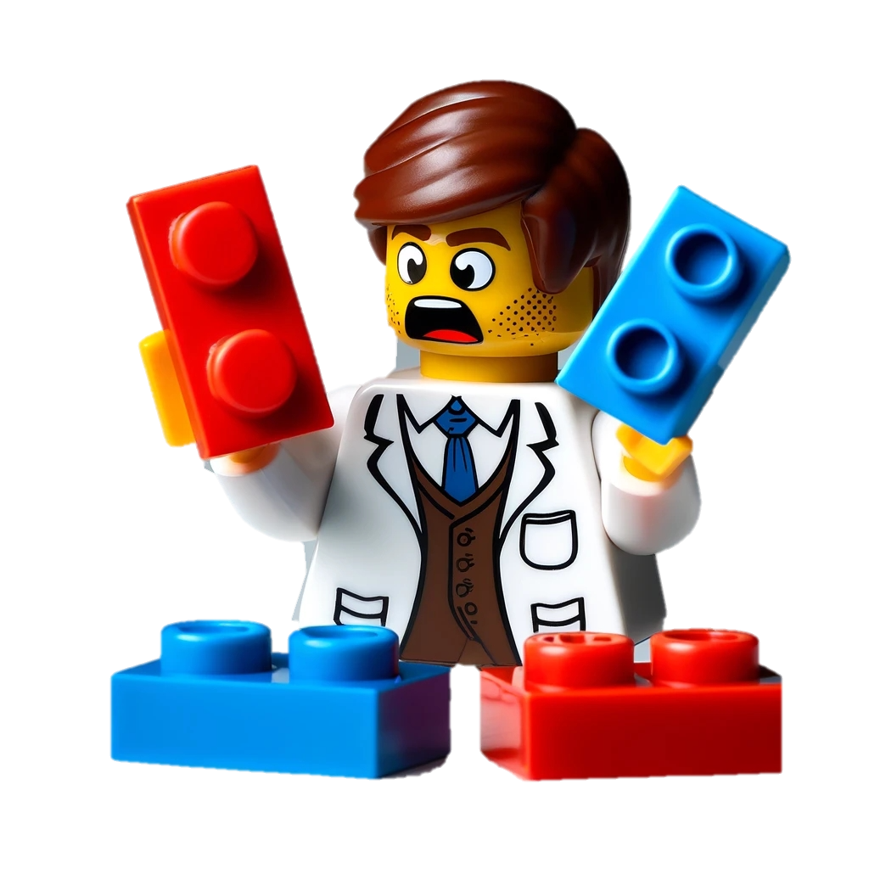
FAIR Data is data that satisfies FAIR Principles
Findable
Accessible
Interoperable

Slide 16
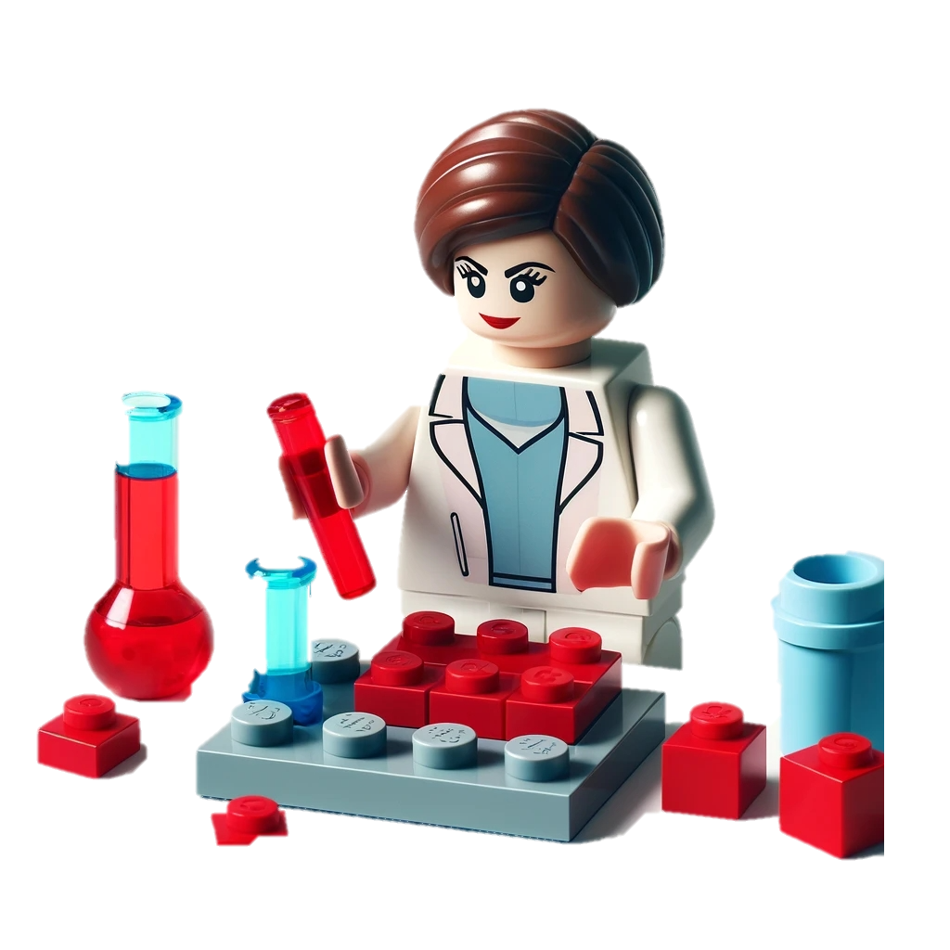
FAIR Data is data that satisfies FAIR Principles
Findable
Accessible
Interoperable
Reusable

Slide 17
Findable
Accessible
Interoperable
Reusable
Open Data
FAIR Data
Notes:
Findable and accessible can be covered by being open, but not other two

Slide 18
Open ≠ FAIR
Notes:
Open doesn’t mean FAIR

Slide 19
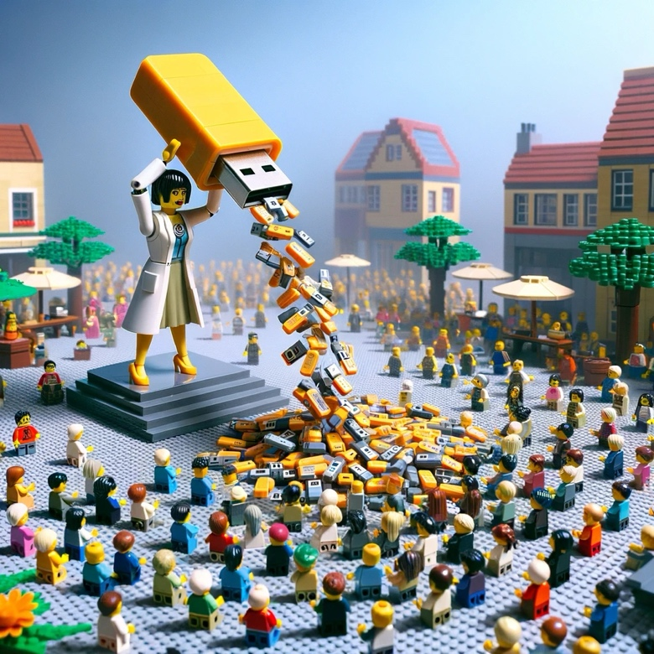

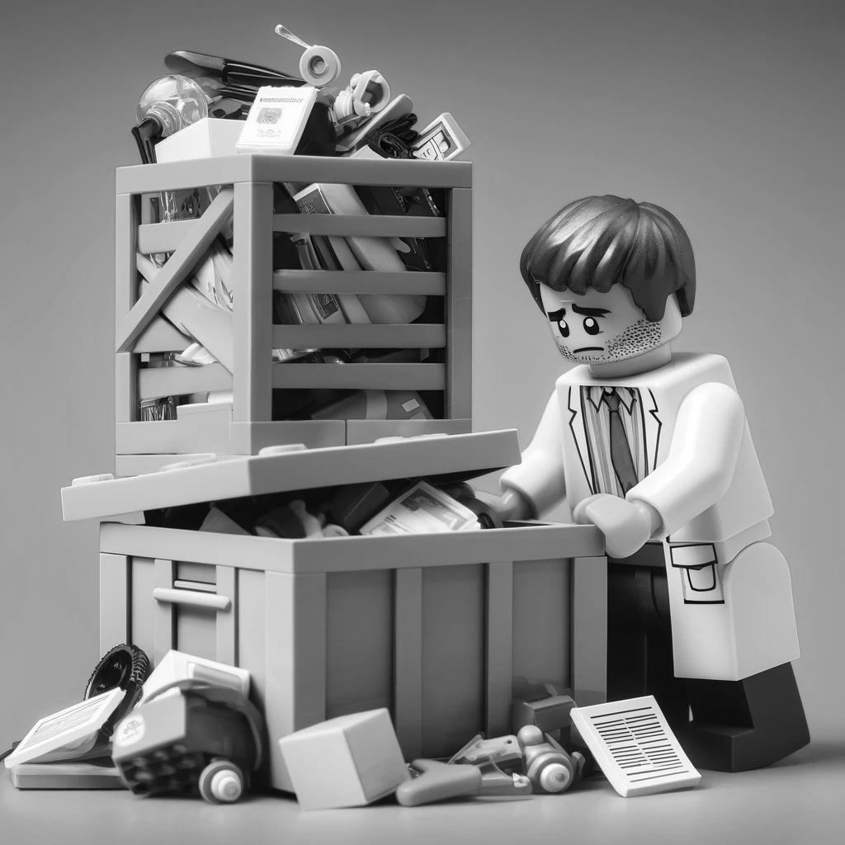

FAIR & Open
Yes
Open
No
No
Yes
FAIR
Notes:
Open data can be not FAIR. At the same time, FAIR data can be closed, not open.

Slide 20
What do you do with your data when you finish your project?

Slide 21





Research Data Management can go wrong
Paper
Data never to be looked at again
Create Data
Consume Data
Data loss & research waste
Notes:
Traditionally, we thought research data as something to be consumed, with a dead end

Slide 22




We can also do it better: efficient & sustainable
Plan
Share & Reuse
Collect
Process & Analyze
Archive
Adopted from RDMkit: https://rdmkit.elixir-europe.org/data_life_cycle
Notes:
Research data management concerns the way you collect, analyze, store, share, archive and publish research data, to satisfy the needs of current and future data users​.

Slide 23




Community standards, funders, and laws require good RDM
Code of Conduct for Research Integrity
Funders
GDPR
Code of Conduct for Research Integrity: nwo.nl/en/netherlands-code-conduct-research-integrity
NWO Grant Rules: nwo.nl/en/nwo-grant-rules

Slide 24




Less likely to lose data
Good RDM benefits you and the research community
Recognition
Protection for integrity
More efficient & sustainable science
Code of Conduct for Research Integrity: nwo.nl/en/netherlands-code-conduct-research-integrity
NWO Grant Rules: nwo.nl/en/nwo-grant-rules

Slide 25
How to plan for your research project

Slide 26
Data Management Plan
A living document for the research project
Funding agencies require data management plans, reviewed by a data steward
At TU/e, you can prepare a Data Management Plan on the Research Cockpit (more on this later)

Slide 27
What kind of data do you have?
A. Data from human participants
B. Sensitive Data
C. Data from external parties

Slide 28

Ethical review is required for all research involving human data at TU/e
*including anonymous / secondary data
ERB application can be submitted after creating a Data Management Plan on Research Cockpit
Research Cockpit: cockpit.research.tue.nl
Ethical Review | TU/e : tuenl.sharepoint.com/sites/intranet-ethical-review

Slide 29

Pla
Personal Data: Any data that can be traced back to a living person
Normal Personal Data
Special Category Personal Data
Privacy Handbook | UU: https://utrechtuniversity.github.io/dataprivacyhandbook/definitions.html

Slide 30
GDPR prohibits processing special categories of personal data except certain circumstances
Racial or ethnic origin
Political opinions
Religious or philosophical beliefs
Trade union membership
Genetic and biometric data for identification
Sex life or sexual orientation
Health Data
Data Processing Impact Assessment (DPIA) may be needed
Contact your data steward if you plan to process special categories personal data
Privacy Handbook | UU: https://utrechtuniversity.github.io/dataprivacyhandbook/definitions.html

Slide 31

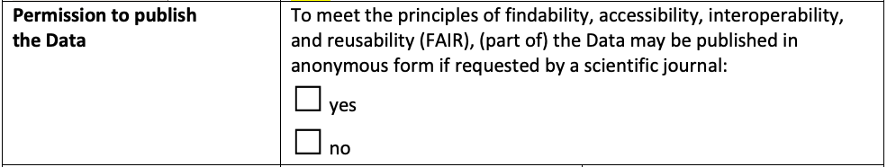
If you are getting data from an external party, it’s best to have an agreement about data
Will your party agree to publish your data?
Data Sharing Agreement Template TU/e Receiver
Agreements | TU/e: https://tuenl.sharepoint.com/sites/intranet-privacy-security/SitePages/agreements.aspx

Slide 32

When writing a grant proposal, it’s best to reserve funding for RDM-related costs
“Data management and making the data FAIR (assigning DOI, describing the data, assigning metadata to the data, etc.) is part of the ongoing research activities of involved researchers. Although we do not foresee any extra expenses, a budget of €5000 is reserved for RDM purposes.”
Costs of data management | UU https://www.uu.nl/en/research/research-data-management/guides/costs-of-data-management

Slide 33
We’ll try out the Research Cockpit later today

Slide 34
Collecting Phase

Slide 35
Set your folder structure and document it in the README file
.
├── README.md
├── metadata.json
├── data/
│ ├── raw
│ └── processed
├── code/
├── output/
└── documentation/
├── methods
├── lab_notebooks
└── administration

Slide 36
Make a README file to make your data human-friendly
No one can read your mind—not even you in the future
Make a README: makeareadme.com/
Guide to writing “readme” style metadata | Cornell: data.research.cornell.edu/data-management/sharing/readme/

Slide 37
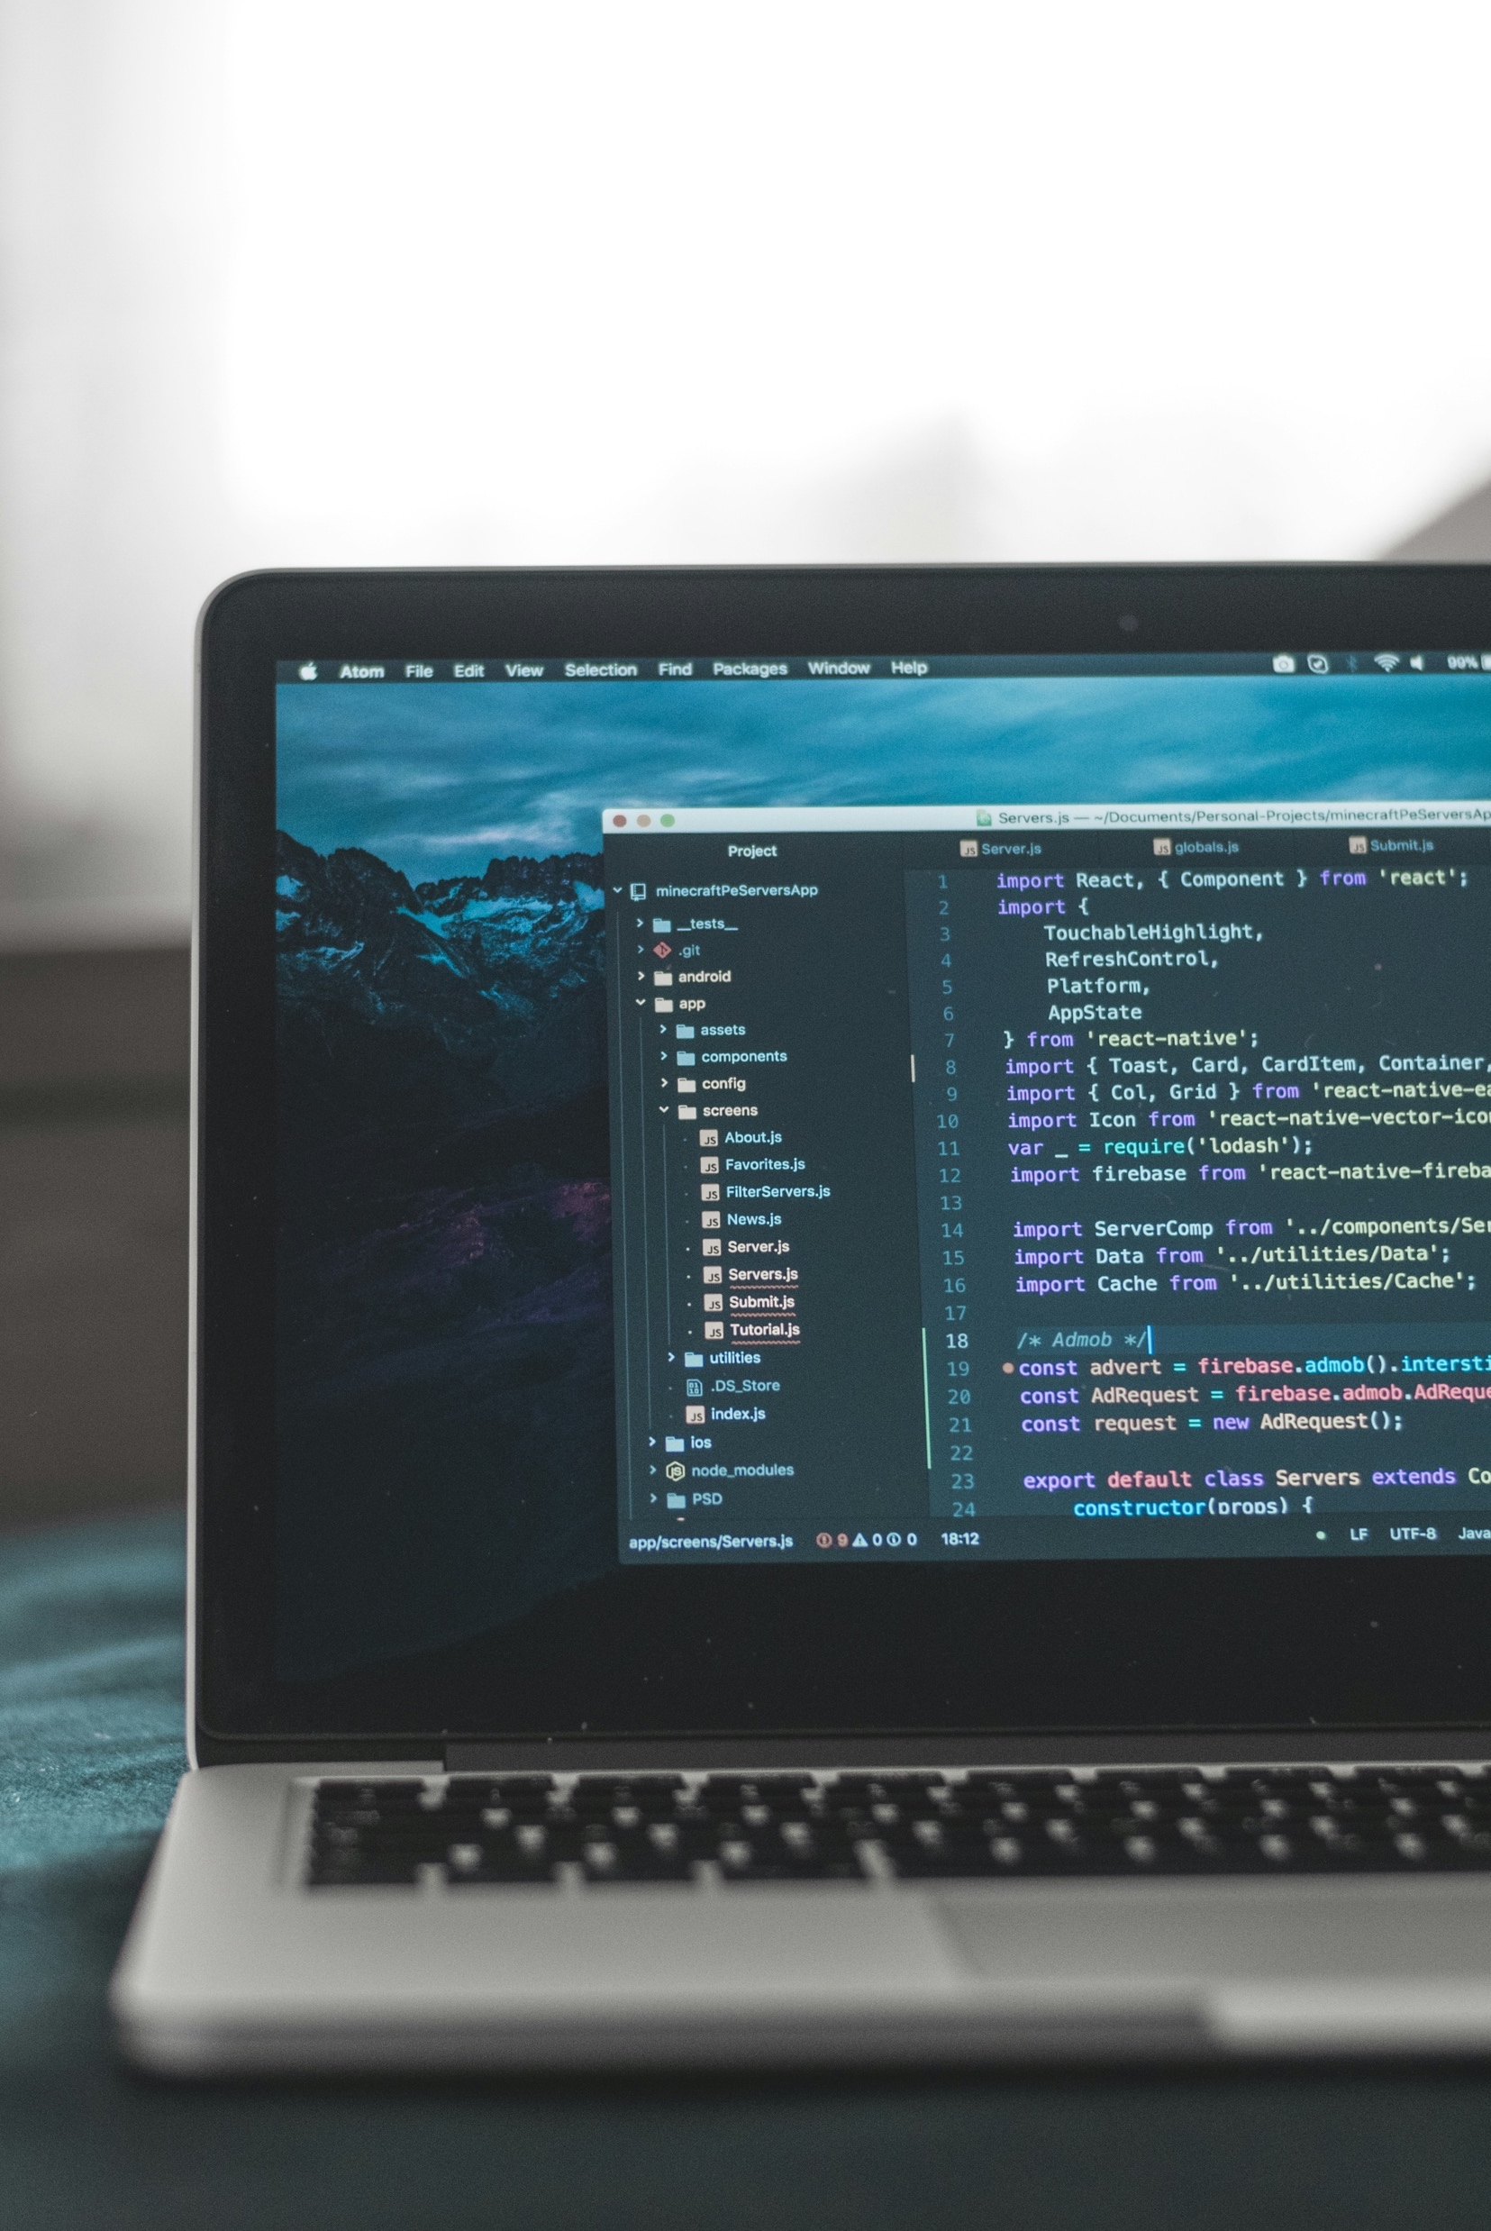
A metadata file makes your data machine-readable
You can complete a dataset form on 4TU.ResearchData or Zenodo, download the metadata file, and save it together with your data.
*You can also manually create metadata file using DataCite Metadata Generator
Photo by AltumCode on Unsplash
DataCite Metadata Generator: dhvlab.gwi.uni-muenchen.de/datacite-generator/

Slide 38
Name files meaningfully, distinctly, and consistently
No special characters. Whitespaces are discouraged.
Case style: camelCase, PascalCase, snake_case, or kebab-case?
Use ISO date format: “2024-07-03”
Turing Way: https://book.the-turing-way.org/project-design/filenaming.html

Slide 39
Storage options at TU/e

Slide 40
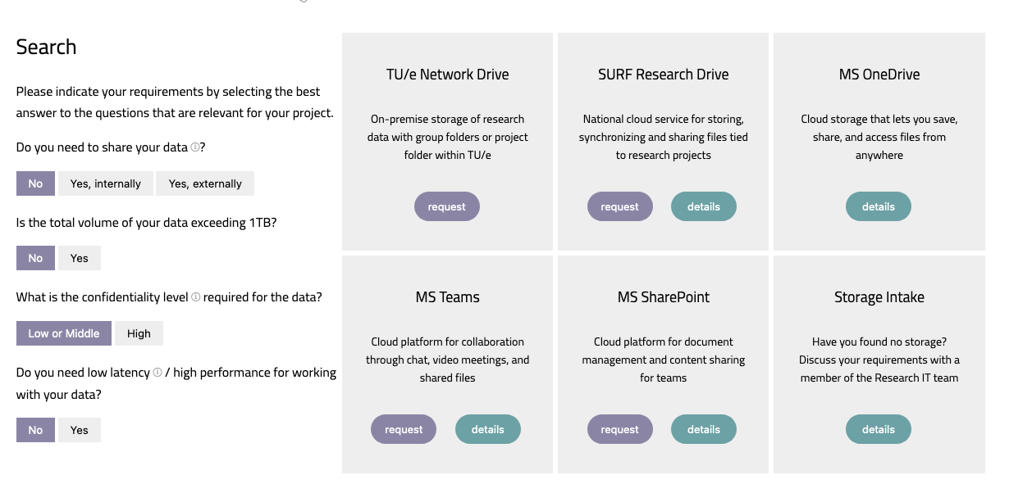
Storage Finder at Solution Searcher
https://openpar.pages.tue.nl/solution-searcher/category-storage.html

Slide 41
Where do you store your data?
A. TU/e Network Drive
D. OneDrive
B. SURF Research Drive
E. Other
C. Teams / SharePoint

Slide 42




Network Drive
TU/e Storage Options
Security
Scalability
Best
Best
(External sharing not possible)
(~100 TB)
Research Drive
Good
Good
(~10 TB)
Teams / SharePoint
OK
Good
(~2.5 TB)
*OneDrive is recommended for student project only

Slide 43

You can encrypt your data using Cryptomator in a vault and store it in any storage solution
You can manage access using Cryptomator Hub
Learn more about Cryptomator Hub on the Research Cockpit: https://cockpit.research.tue.nl/helpcenter/research/portal/11/article/2452390165

Slide 44

Only sending data one-time? Then use SURFfilesender
Remember to turn on encryption
SURFfilesender: filesender.surf.nl/
Do not send data over email!

Slide 45
Processing & Analyzing Data

Slide 46
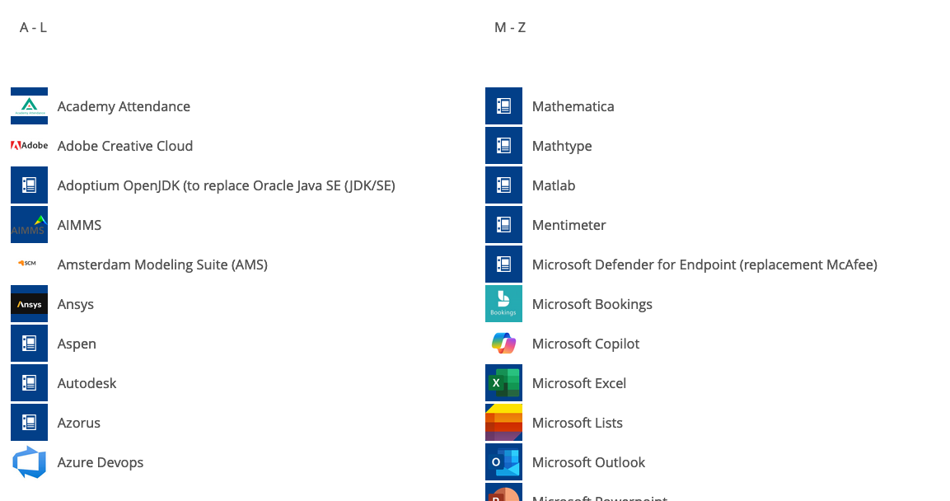
You can find available tools on Topdesk
TU/e Software | Topdesk

Slide 47


The recommendation is to use open-source tools, whenever possible.
R
Python

Slide 48
If the original dataset is in a proprietary format, convert it to an open file format.
e.g., text file, HDF5, NetCDF

Slide 49
Do you need to use proprietary tools?
Any opportunities for using open tools?

Slide 50
Archiving
Share & Reuse

Slide 51
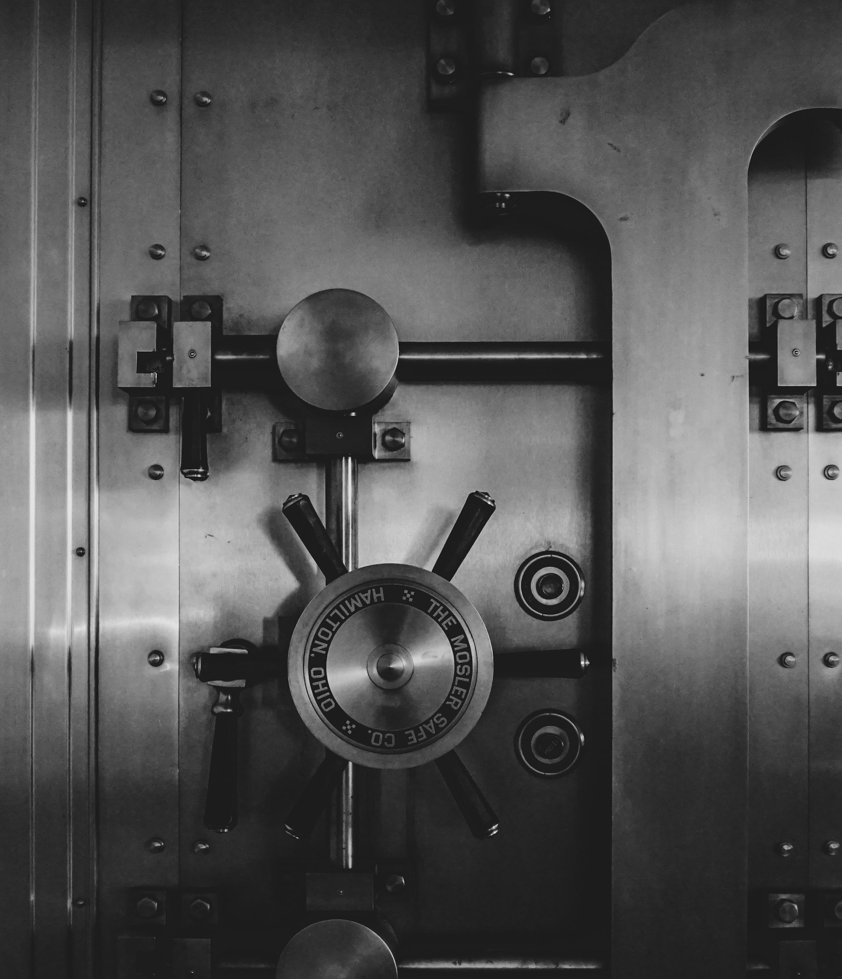
Archiving: keeping data to demonstrate the integrity of research
Usually, each publication requires an archival package
Archival package is only accessed when it’s needed
Photo by Jason Dent on Unsplash

Slide 52
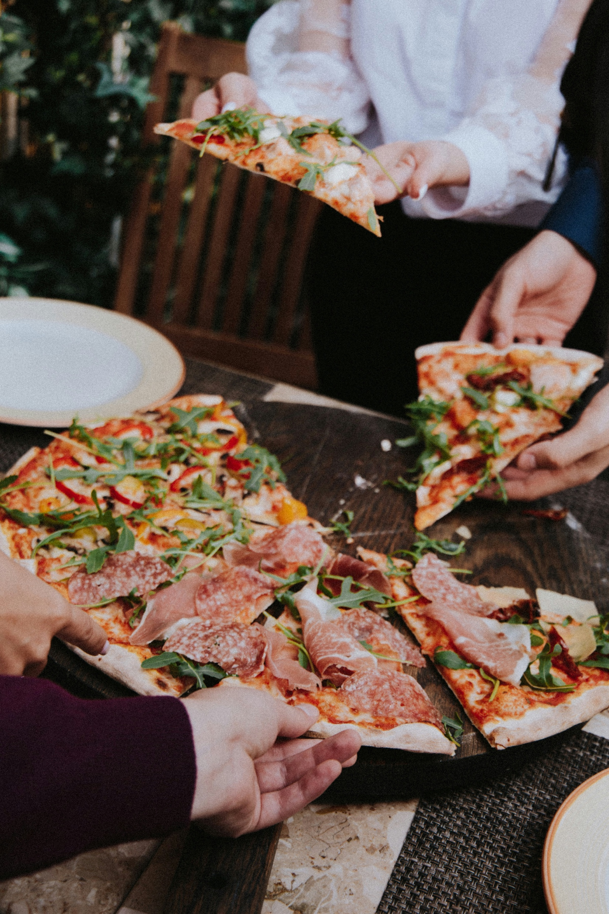
Sharing: Creating a publication data package to share your data
The goal is to share data with future data users (can be you)

Slide 53




Publication Package
Archival Package
To share
To demonstrate integrity
Main Goal
Public
Restricted
Access
By default

Slide 54


You can deposit data in a data repository & connect your publication.
You can use generic repositories, such as 4TU.ResearchData & Zenodo.
Your discipline may have a specialized data repository. Visit re3data.org to find out.

Slide 55


When sharing your research, assign an open license, for example
Data, documentation, non-code materials
Code
CC BY 4.0
MIT
https://chooser-beta.creativecommons.org/
https://choosealicense.com/

Slide 56
Share your data as openly as possible as closed as necessary
That said, look out for limitations related to privacy, intellectual property, or data agreements
FAIR Data Management in Horizon 2020: ec.europa.eu/research/participants/data/ref/h2020/grants_manual/hi/oa_pilot/h2020-hi-oa-data-mgt_en.pdf

Slide 57
The future user of your data may be you

Slide 58
Managing Research Data can be overwhelming…

Slide 59
It’s best to plan ahead to avoid chaos at the end

Slide 60
Effort
“What did I do again?”
“Where’s my data?”
“No time to spend for planning now.”
Project Start
Project End
Notes:
(In the past, we scramble ourselves to structure metadata and data at the end of the project )
But, it’s worse way to do it—time consuming, accuracy, remembering everything, “past you”

Slide 61
Ideal: Start with the end in mind

Slide 62
Effort
Completing a Data Management Plan
Data publication & archiving as planned
Project Start
Project End

Slide 63
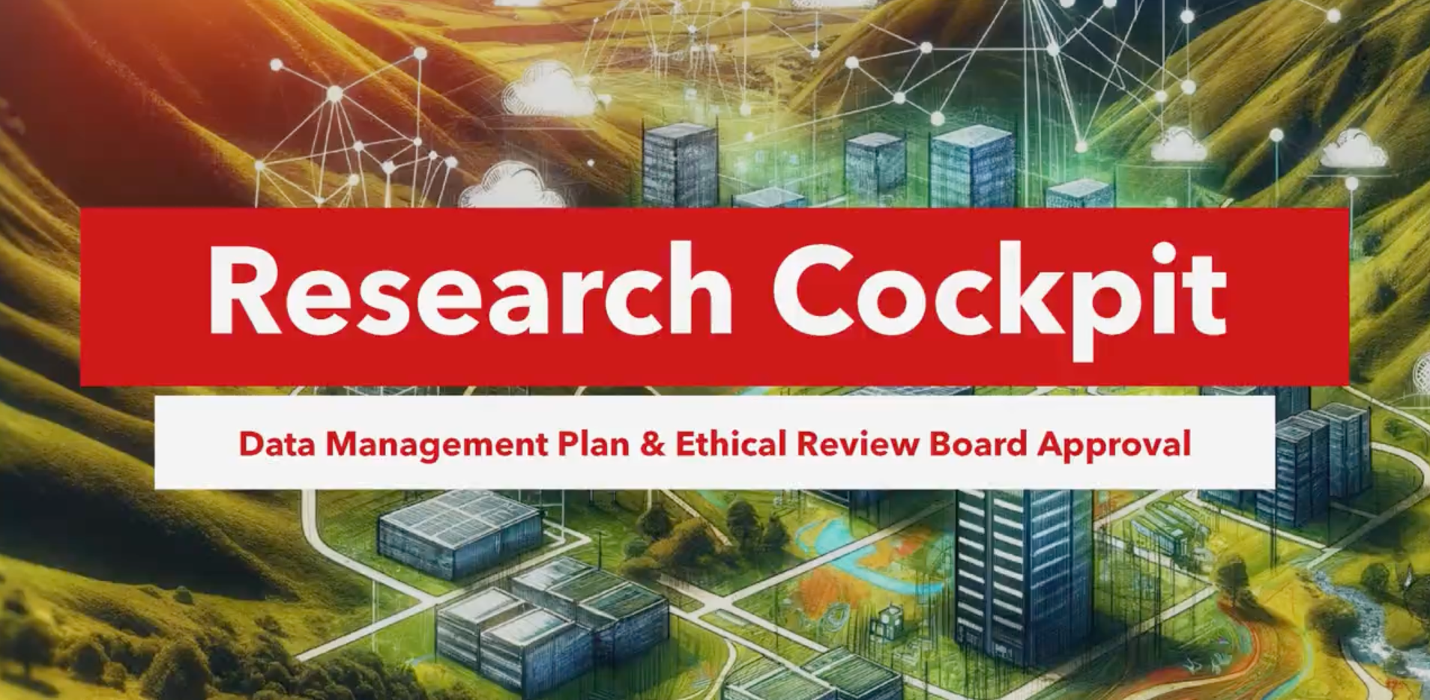
Research Cockpit
https://cockpit.research.tue.nl

Slide 64
Let’s try out the Research Cockpit!

Slide 65
General workflow
Project Registration
Data Management Plan
If needed
Ethics Application

Slide 66
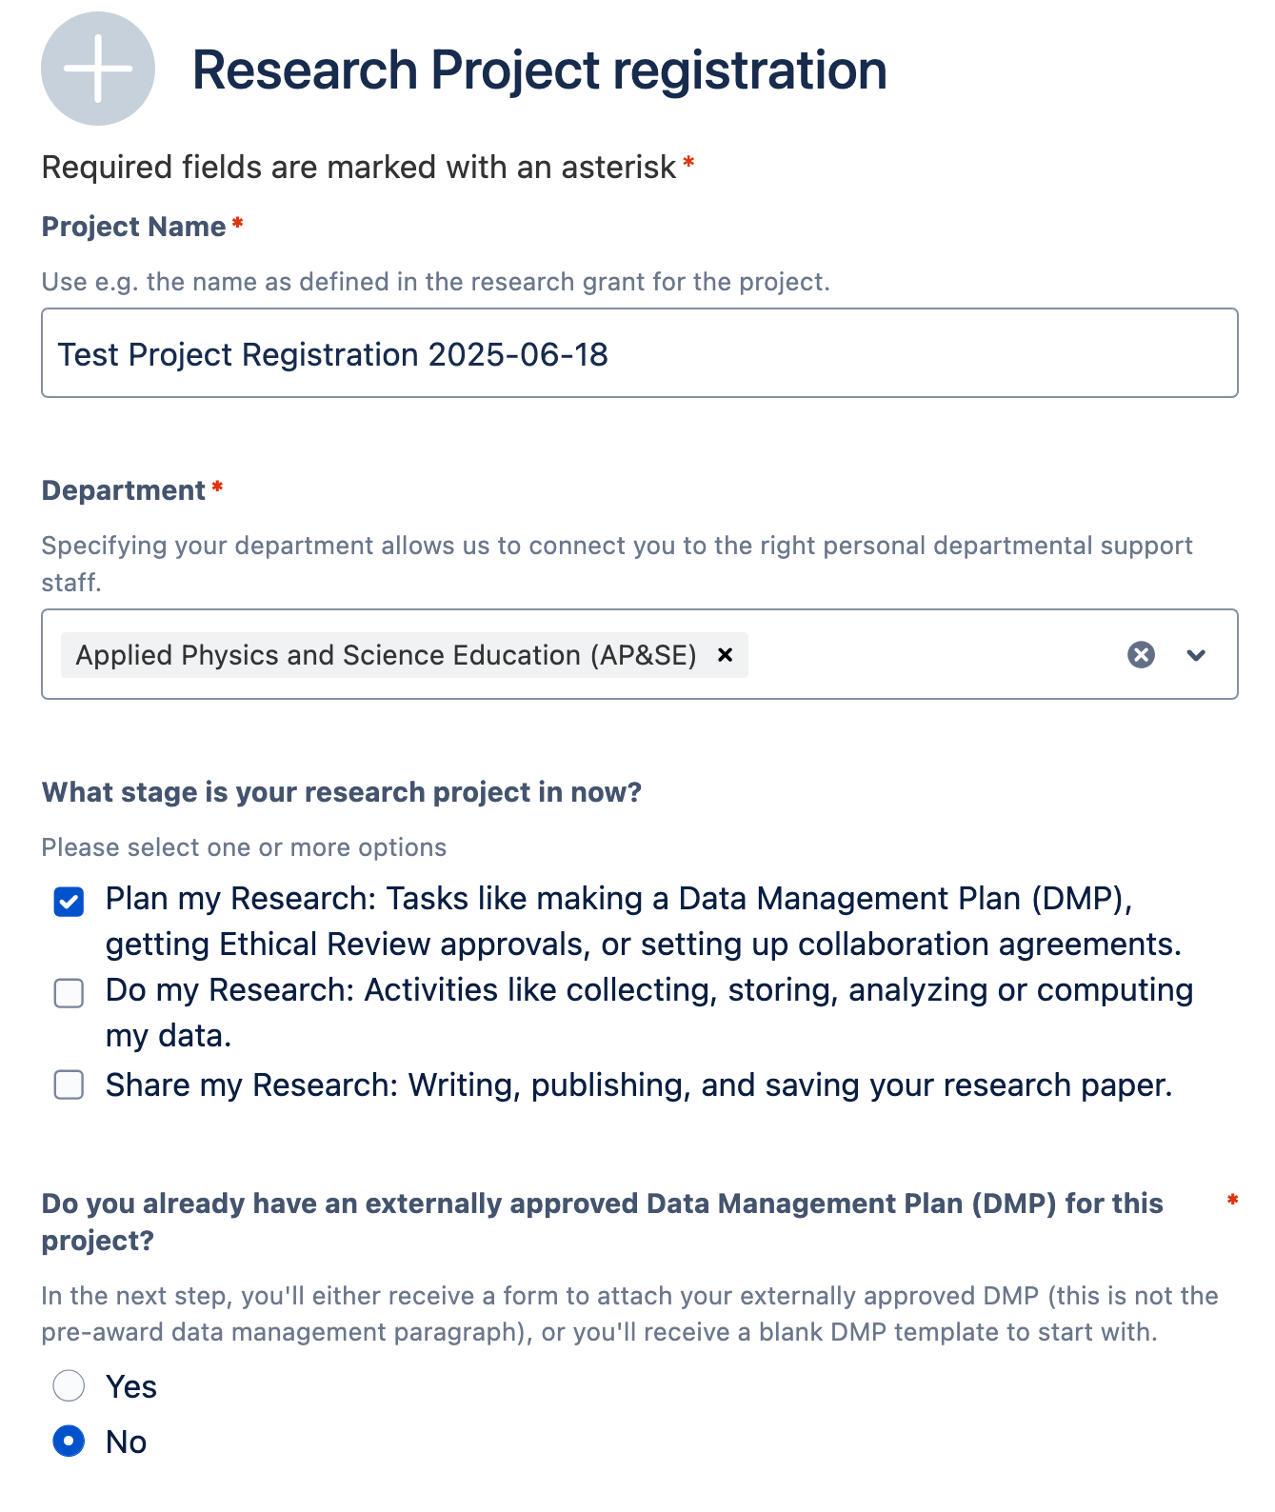
Project Registration
Visit Research Cockpit (cockpit.research.tue.nl)
Find “Data Management Plan”
Find ”Create a Data Management Plan
Fill in Research Project Registration
Click “Send”

Slide 67
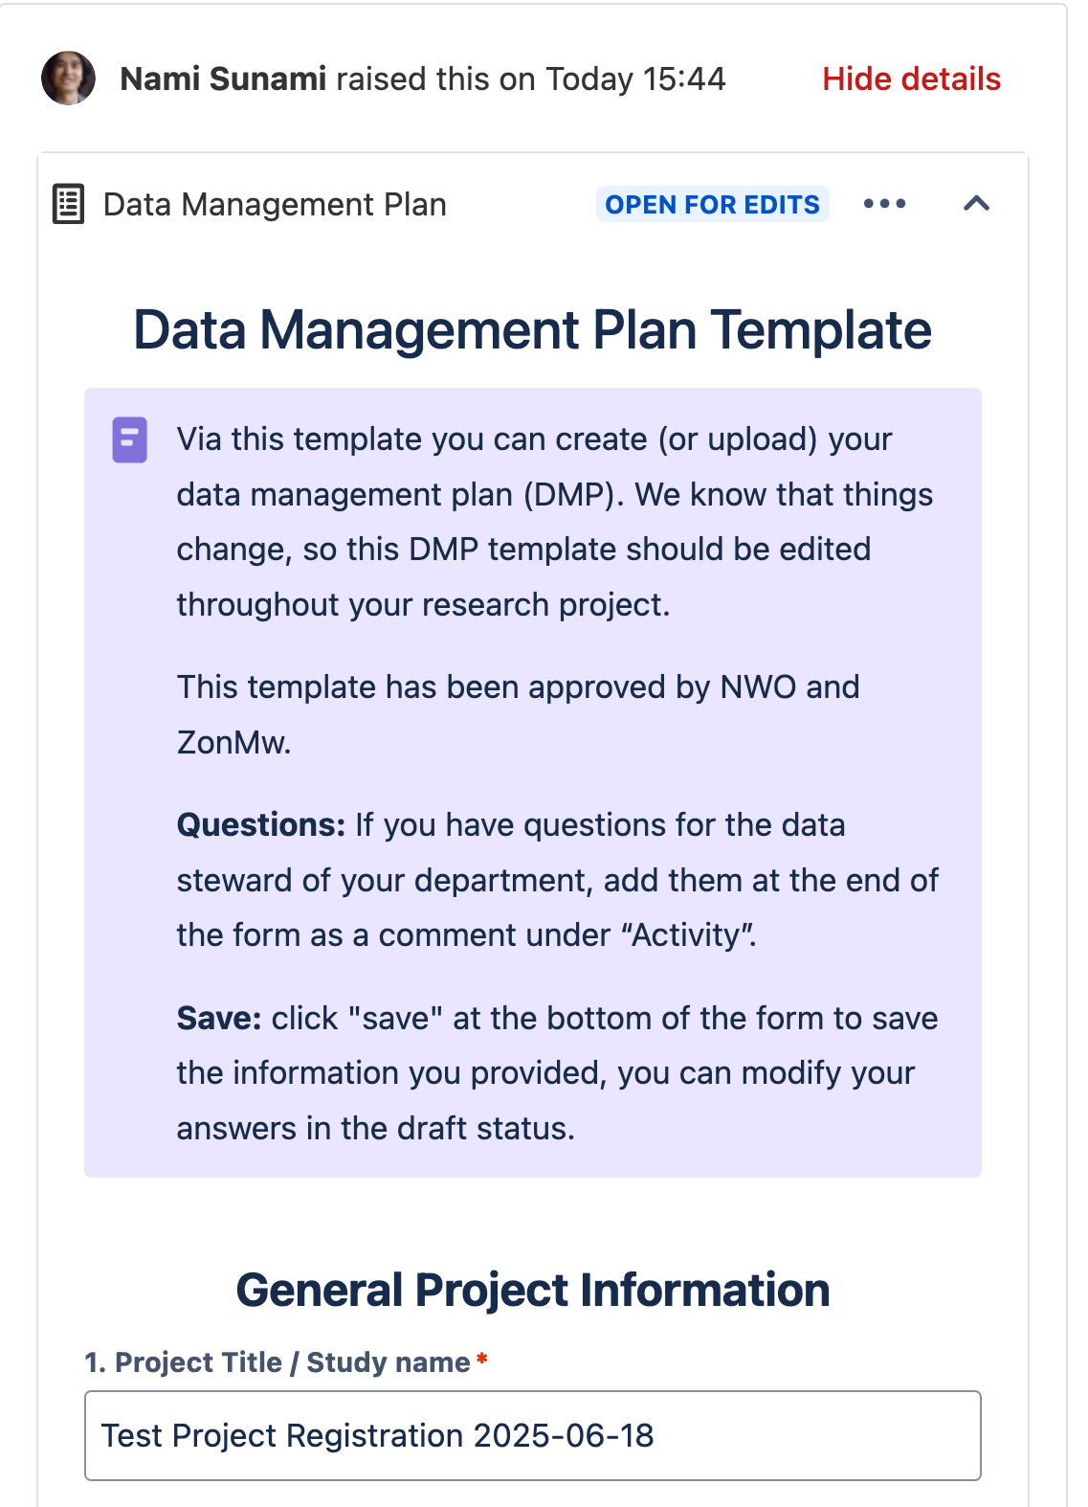

Data Management Plan (DMP)
Go to your avatar -> Requests
Find your Draft DMP
Fill in the information in the DMP
You can share your DMP with your collaborators
If you no longer need the DMP, please retract it.

Slide 68
How was your experience with the Research Cockpit?

Slide 69
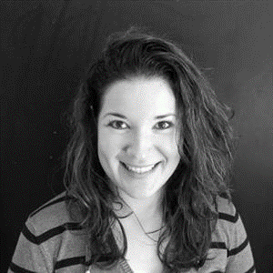

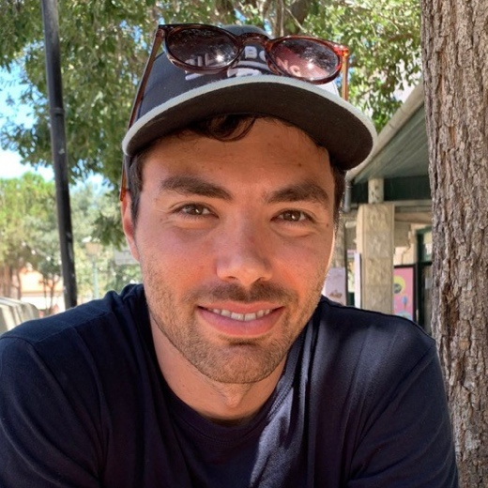
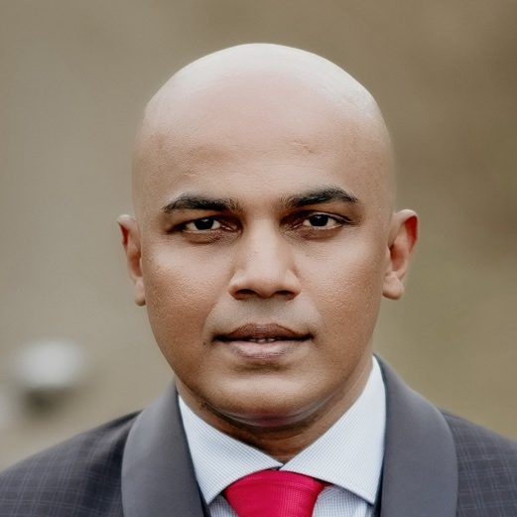

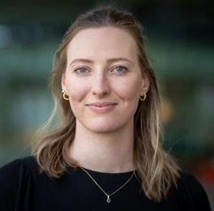
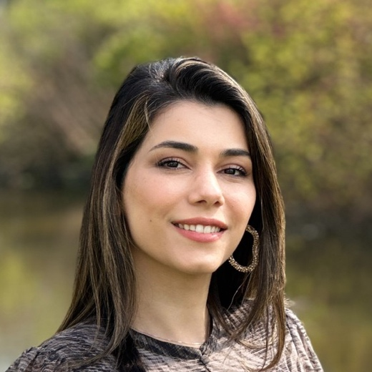
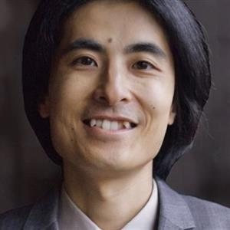
Don’t hesitate to reach out to your Data Steward
Liz Guzman-Ramirez
Coordinator
Angela Aleksovska
EE
Davide Nardi
M&CS
Jay Nair
IE&IS
Jonathan Genora
ID
Lucia Forrová BE
Neda Norouzi
BME, ME
Nami Sunami
CE&C, APSE
rdmsupport@tue.nl
rdm.tue.nl
Data Stewards | SharePoint (login required)

Slide 70
Thank you
More info on RDM
Contact Data Steward
rdmsupport@tue.nl
Data Stewards | Intranet
TU/e Research Data Management
Search Storage | Storage Searcher
Create a DMP/ ERB
Research Cockpit

